Slide 1
SGMP Strategic Plan
2024-2028

Slide 2
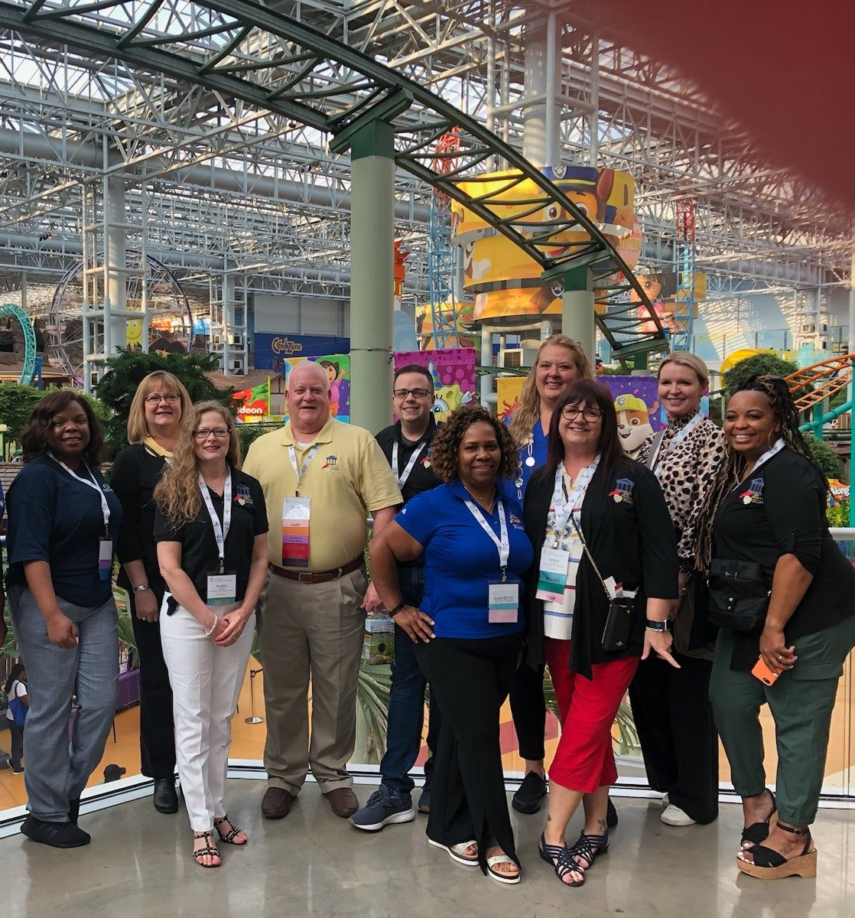
About SGMP
The Society of Government Meeting Professionals (SGMP) was founded in 1981 and is the only national organization in the United States dedicated exclusively to individuals who plan and execute government meetings. We deliver our membership value of education, resources and networking to nearly 1,500 members in 18 chapters and 3 satellite chapters across the country. Our National Education Conference and Expo is held annually, and we offer Certified Government Meeting Professional (CGMP) certification to planners and suppliers who demonstrate their expertise with the rules and regulations of running high impact, ethical government meetings.
The mission of SGMP is to enhance and promote the expertise of government meeting professionals; and to improve the quality and increase the cost effectiveness of government meetings by:
Improving communications, understanding, and cooperation between meeting planners and suppliers through periodic meetings;
Expanding the knowledge and abilities of meeting planners and suppliers by conducting formal educational programs;
Aiding planners in locating and evaluating meetings facilities and support services;
Researching, analyzing and translating regulatory and legislative issues and policies which affect government meetings;
Influencing in decision-making that directly or indirectly impacts the scope of operations of the meeting planners;
Maintaining liaison activities with other professional meeting planner and supplier groups; and,
Providing guidance and advice to meeting planners on all phases of planning, executing, and evaluating government meetings
We expand our members' expertise by delivering our membership value of education, resources, and networking through 18 chapters and 3 satellite chapters.

Slide 3
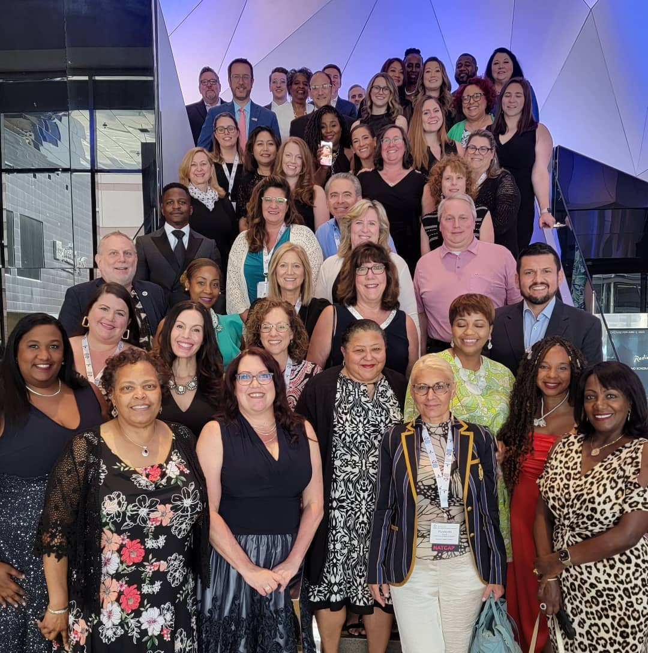
Initiating Factors
The mean length of membership is 5.97 years, the median length of membership is 3.00 years, and the mode is 1.05 years. While SGMP has made significant efforts to recruit and retain members, efforts at member retention have not been sufficient to effect member retention and overall net membership growth.
This strategic plan aims to promote improved member retention to build SGMP membership and increase member satisfaction.

Slide 4
Pre-Plan Initiatives (April – December 2023
Management – in April to August 2023, SGMP recruited and onboarded new management, including Dr. Katie Herndon as Executive Director; and Alan Kleinfeld, CMP, CGMP as Education Director.
Infrastructure – In November 2023, SGMP launched a new website and Association Management Software (AMS). This new platform modernizes member management and facilitates ease of access to member data and resources. In January 2024, SGMP will launch a new Learning Management Software (LMS) to host on-demand online learning opportunities for members. From December 2023 – December 2024, SGMP will support the migration of Chapter websites and AMS platforms to the national AMS/website host.
Transparency – SGMP is committed to keeping members informed through regular posting of financial and management documents on the SGMP website.
Chapters – SGMP is proud to welcome new satellite chapters, expanding our reach across the U.S. We are also proud to expand our EIC license and develop new awards to recognize our volunteers for their efforts.
Education – Beginning in 2024, SGMP will launch a fully-updated CGMP course to be made available in three convenient formats to suit the variety of adult learning styles: on-demand, synchronous virtual, and in-person. Additionally, SGMP will offer online credit tracking for CGMP continuing education.
National Education Conference – SGMP is pleased to announce that the NEC has been restored to its pre-pandemic full schedule. Attendees have the opportunity to earn up to 10 hours of continuing education, from new speakers and in interactive sessions.

Slide 5
Capacity Building

Slide 6
Capacity Building Initiatives: Technology
AMS + Website
Career Center – The new and improved SGMP Career Center will feature automated job posting, resume services, and additional features designed to facilitate a robust career interaction between members.
Discussion Boards and Circles – SGMP will facilitate hosted discussions via the SGMP message boards available via the SGMP website.
Committees – SGMP will host committee resources for national committees and chapters via the new website.
LMS
Webinar recordings – the LMS will feature recordings of all SGMP webinars.
Chapter education – SGMP chapters will have access to hosting on the new LMS for all recorded presentations. Chapters will have the option to make sessions available to chapter members only or to the full membership.
NEC Sessions – SGMP will record live sessions at the National Education Conference to house in the new LMS.
Certification & Recertification – SGMP will house both training and records of training for SGMP certifications in the new LMS.

Slide 7
Capacity Building Initiatives: Membership
SGMP will make available bulk member discounts to both suppliers and contract planners.
SGMP will conduct outreach to targeted agencies and offices for 100% membership.
SGMP will conduct a quarterly membership campaign offering a free SGMP webinar to non-members as a sneak peek at the benefits of SGMP membership. Non-members who attend will receive a $50 discount on the subsequent purchase of a CGMP class or NEC registration.
SGMP will update and publish new membership recruiting materials with a dual-side format, allowing chapters to include chapter-specific information on one side, national SGMP information on the other side.

Slide 8
Capacity Building Initiatives: Awards
SGMP will launch a Legacy Award to honor members who have committed a minimum of 10 years of service to SGMP.
SGMP will streamline the application process for all chapter awards to promote chapter excellence, honor chapter initiatives, and simplify participation.

Slide 9
Capacity Building Initiatives: DEI
SGMP will seek out and engage diverse speakers for events (both virtual and in-person).
SGMP will seek out and honor diverse leaders in the government meeting industry.
SGMP will develop a new core competency focused on diversity, equity, and inclusion to promote efforts of meeting planners in these important areas.
SGMP will seek out other opportunities to promote diversity, equity, and inclusion in our society.
SGMP’s DEI committee will seek to define and expand the scope of our mission of inclusiveness.

Slide 10
Capacity Building Initiatives: Transparency
SGMP will publish and regularly update meeting minutes and financial reports to the SGMP website.
SGMP will resume annual audits of financial records.
SGMP will align policies with the highest level of transparency.
SGMP will continue to open all board meetings to guest attendance.

Slide 11
Member Benefits Enhancements: Education

Slide 12
Career Span Professional Development
Early Career
CGMP
Mid-Career
Level 2 Micro-credentials
Advanced-Career
Chapter Education
Chapter Education
NEC
Level 1 Micro-credentials
Chapter Education
NEC
Webinars
Webinars
NEC
Webinars
Level 3 Micro-credentials
Advanced CGMP
Leadership Training & Career Development
CGMP Congress

Slide 13
Professional Development for Member Retention
New Model
Current Model
Join SGMP, Earn CGMP
Attend NEC, Chapter Events, Webinars, Renew CGMP
Join SGMP
Earn CGMP
Earn Level 1 Micro-Credentials
Earn Level 2 Micro-Credentials
Earn Advanced CGMP
Earn Level 3 Micro-Credentials
Business & Leadership Training
Attend CGMP Congress

Slide 14
CGMP Enhancements & Expansion
Updated CGMP Course
Additional Course Formats
CGMP Congress
Advanced CGMP
The CGMP course will be updated to present the newest and most relevant information, and will feature new materials:
Textbook (available both in PDF and print format)
Examination (available in an online format)
The CGMP will be offered in 3 formats beginning in 2024:
Live (at the NEC & by chapter/company request)
Synchronous Virtual (Quarterly)
Online on-demand
SGMP will re-launch the CGMP congress, designed to offer advanced education to mid-career professionals who hold an active CGMP.
SGMP will develop an advanced CGMP course which may parallel the EIC’s CMP/CMM model. This course will launch in 2025.

Slide 15
Micro-credentials
Core
Competencies
Education & Programming
Ethics
Facilities & Services
Financial & Contract Management
Logistics
Personal & Professional Development
Protocol
Technology
Travel
SGMP will revise the current 9 domains of core competency (Education & Programming, Ethics, Facilities & Services, Financial & Contract Management, Logistics, Personal & Professional Development, Protocol, Technology, and Travel) to include new domains such as:
Leadership
Business Management
Diversity, Equity, and Inclusion
Built upon the framework of core competencies, SGMP will launch micro-credentialing programs for each domain of core competency.
Each certificate will have 3 levels: early, intermediate, and advanced.
Each certificate program will include professional development opportunities/requirements from the LMS, chapter events, webinars, and the NEC.
The GIL will determine the syllabus and requirements for each certificate.
The GIL will recruit speakers/presenters/instructors to develop content for the LMS.
SGMP will recognize the GMS certificate as an official micro-credential.
Leadership
Business Management
Diversity, Equity, and Inclusion

Slide 16
Chapter Capacity

Slide 17
Speakers Bureau
To simplify speaker booking for chapters, the LMS, webinars, and the NEC, SGMP will develop an online database of speakers searchable by:
Core Competency
Geography
Price
Recent SGMP engagements
By booking speakers vetted by SGMP, Chapters will be able to offer the highest quality educational programming at the chapter level.

Slide 18
Course in a Box
SGMP will develop pre-planned educational programming, including course objectives, outlines, slides, and handouts for chapters to use as ready-to-present sessions at chapter events. These sessions will cover one or more core competencies.

Slide 19
Standard Education Calendar
SGMP will draft and promote a standard education calendar for FY24-25 for chapters to synchronize education efforts. The calendar will designate a different core competency for each month. Chapters can create their own programming or rely on other chapter efforts to offer programming to members.

Slide 20
Tools & Resources
SGMP will make its Zoom webinar platform and LMS available to chapters to present chapter-level webinars. Additional tools and technologies will be made available to chapters upon request.

Slide 21
Speaker Funding
SGMP will budget additional funding for chapters to recruit high-quality speakers. Chapters will be eligible to apply for funding once each fiscal year to secure a speaker for a chapter programming event.

Slide 22
Other Initiatives

Slide 23
Mentoring
To support career growth and development at all stages, SGMP will pilot a mentoring program, to be launched in 2025. This program will enable planners and suppliers to progress in their career from early to mid-career, and from mid-career to advanced-career.
Mentors will have the opportunity to earn professional development credit from participation.

Slide 24
Leadership & Career Training
To benefit SGMP’s advanced and mid-career professionals, SGMP will develop a leadership & career training program. Sessions will be available on the LMS, at the NEC, via webinar, and at the re-launched CGMP Congress. SGMP will partner with external organizations to offer business, management, and career training opportunities.

Slide 25
Interactive Sessions
SGMP will leverage the power of in-person training to offer hands-on, interactive sessions at the NEC. SGMP will pilot this program at the 2024 NEC. Training sessions will allow attendees to benefit from interactive sessions in content areas such as finance & contract management, logistics, facilities & services, and other areas of core competency.

Slide 26
Supplier-Focused Initiatives

Slide 27
Supplier Initiatives
Supplier Education
SGMP will develop supplier-focused educational programming and content to be made available at the NEC, Bootcamp, webinars, LMS platform, CGMP class, and Government Connections Magazine. These programs will ensure that SGMP supplier members are the go-to preferred choice of SGMP planner members.
Online Buyers Guide
SGMP currently sources an Online Buyers Guide from Naylor Association Solutions. This guide allows planners to connect with relevant suppliers to source business needs. The current guide will be re-developed to offer more value to supplier members, and marketed to SGMP planner members to help connect planner members with supplier members.
RF-Portal
SGMP will develop a web portal, available to SGMP members only, for planner members to post RFPs. RFPs will be searchable by a variety of factors, including dollar amount and geographic location. Supplier members will be notified when a new RFP is posted.

Slide 28
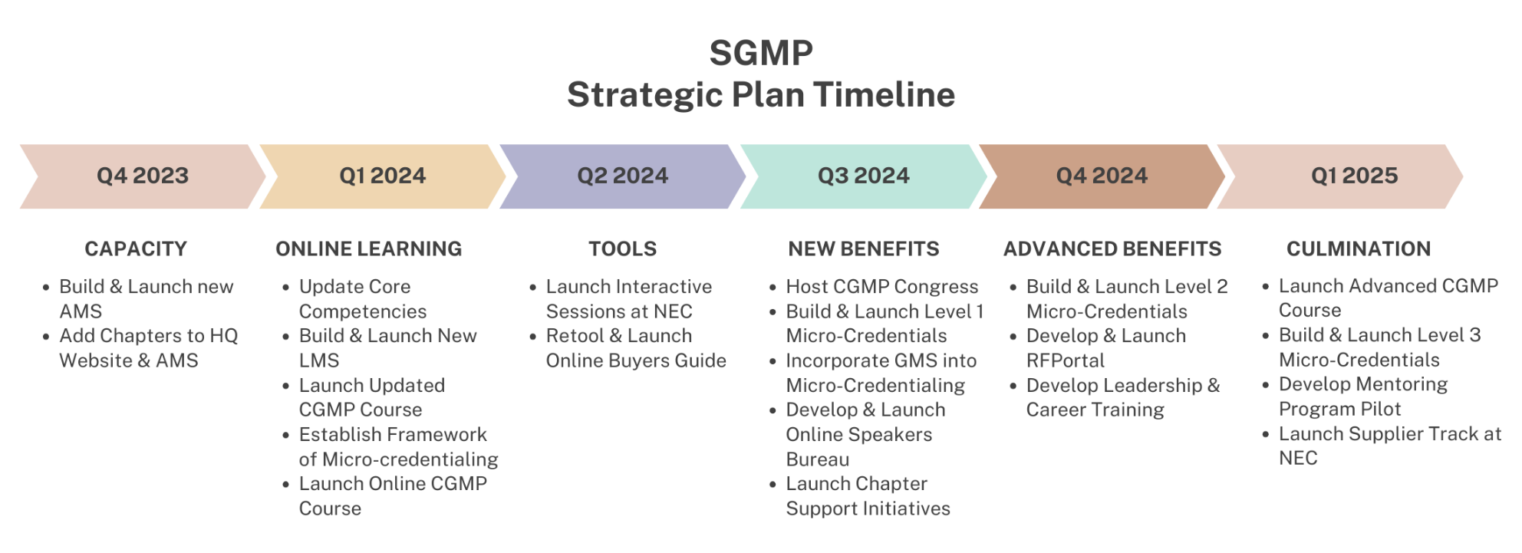
Timeline

Slide 29
Communications & Metrics

Slide 30
Internal Stakeholders
Chapter Leadership & Gilmer Trustees – SGMP will ensure all SGMP leaders are apprised of all strategic initiatives, the timeline of each initiative, the benefits of each initiative, and the role of SGMP leadership in each initiative by communicating the strategic plan through the following channels:
Joint Leadership Meeting
President’s Calls
Email
Chapter Toolkit
Web-based presentation(s)
Liaisons
Flyers and other materials
Ongoing updates
Members – SGMP will update our membership on the strategic plan via a coordinated communications initiative via the SGMP Link, Social Media, the SGMP website, and Government Connections Magazine.
CGMP Students – The SGMP Education Director will ensure that all CGMP students are aware of the myriad benefits of SGMP membership and available learning paths to SGMP members.

Slide 31
External Stakeholders
Former Members – SGMP staff will communicate new available professional development opportunities and resources available to SGMP members to promote member recapture.
SGMP Prospective Members – SGMP will place advertising and write articles for placement in strategic publications (Rob Coffman to advise) to gain exposure to unaware prospective members.
Partner Organizations – SGMP will exhibit, speak, and co-locate programs and resources at partner organization events. SGMP will offer exhibit table swap with partner organizations. SGMP will develop materials for members to share at events they attend.

Slide 32
Measuring Success
SGMP will evaluate the effectiveness of this strategic plan by examining member retention data over the next 1-5 years. Broadly, SGMP’s goals are to:
Reduce attrition by 25%
Increase member retention by 8%
Grow overall membership by 10%

Slide 33
Other Metrics
SGMP also expects to see growth in a variety of metrics such as:
Increased CGMP course enrollment
Increased CGMP renewal
Increased NEC attendance
Increased Social Media Audience
Increased Magazine readership
Increased webinar attendance
Increased chapter event attendance
A minimum of 100 members completing a newly launched SGMP micro-credential program.
The most important aspect of the success of the SGMP 2024-2028 Strategic Plan is the satisfaction and professional growth & development of our members. Our mission is to enhance and promote the expertise of government meeting professionals, and through expanded, career-stage specific professional development opportunities and advanced training, we intend to accomplish this goal.
In August 2024 and August 2025, we will survey our members to determine whether planned programs and initiatives continue to serve member needs, and will adjust as needed.

Slide 34
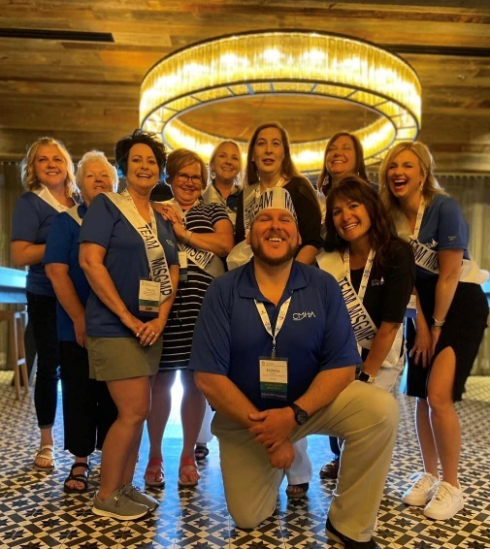
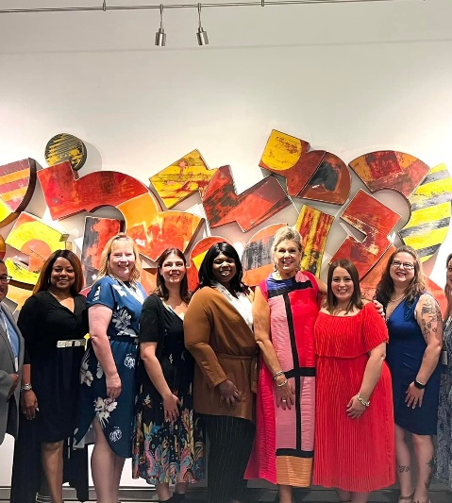
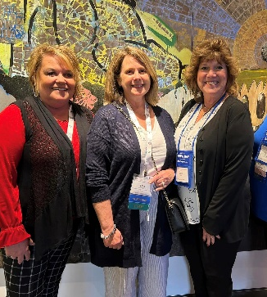
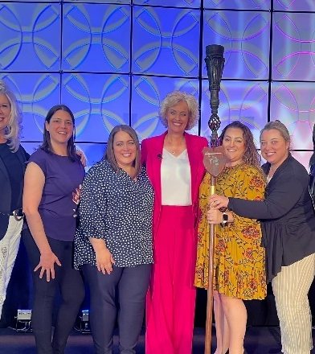
Questions?

